Slide 1

Regional Meteorological Impact Analysis
Comparing RNN Architectures and Gradient Boosting for NYC Temperature & Commerce
Data Science Internship Report | Spring 2026 | Advisor: Dr. Che

Slide 2


Introduction & Motivation
Inspired by an extreme cold snap at the start of the 2026 semester, this research explores the nexus between regional climate patterns and urban economic activity.
•
Foundation: Utilizing climate data as a research baseline.
•
Significance: Everyday impact of weather on planetary life.
•
Objective: Comparing predictive power across different computational architectures.

Slide 3






Standard Operating Processes (SOP)
Extraction
Feature Engineering
Model & Verification
Mapping NCEI station codes and isolating regional CSV data into structured directories.
Creating lag features and cyclical temporal encoding using sine/cosine transformations.
XGBoost with 200 trees, 0.05 learning rate, and 80/20 train-test split validation.

Slide 4


Data Sourcing & Initial Hurdles
The NCEI Dataset Challenge
The Solution
Initial attempts with global datasets resulted in a high 10.07°F average error due to:
Pivoted to a refined Kaggle dataset (1992-2021) for U.S. weather stations, leading to a "mid_atlantic_weather.csv" file.
•
Unit Scaling: Temperatures recorded in tenths of a degree Celsius (e.g., 25°C = 250).
•
Type Inconsistency: Mix of string and float types caused issues with XGBoost calculations.

Slide 5
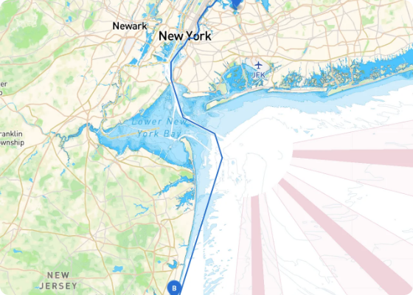
Regional Predictors for NYC
After cleaning data, the XGBoost model achieved a precision of 1.16°F error.
Key Findings:
•
Newark, NJ was identified as the top predictor due to extreme geographic proximity.
•
Removing Newark forced the model to find balanced correlations among remaining regional stations.
•
Primary Factor: Physical distance dominates the model's decision-making process.
•
This is somewhat obvious and as such I decided, to try something different as we will see.
For these predictors, physical proximity to the locations are the best predictors.

Slide 6


Weather-Driven Commerce Inferences
Translating meteorological variables into economic friction levels and logistical shifts.

Slide 7






Rainfall & Economic Friction
Low Friction
Medium Friction
High Friction
0.0 mm: Peak commerce. High foot traffic in districts like SoHo. Logistics operate at max efficiency.
0.1–5.0 mm: The "Digital Shift." In-person traffic drops; spike in E-commerce and food delivery.
> 5.0 mm: Logistical Disruption. Systematic pause in spending. Heavy delays in PA "Logistics Belt."
Average Predictive Error for Rain: 1.81 mm

Slide 8
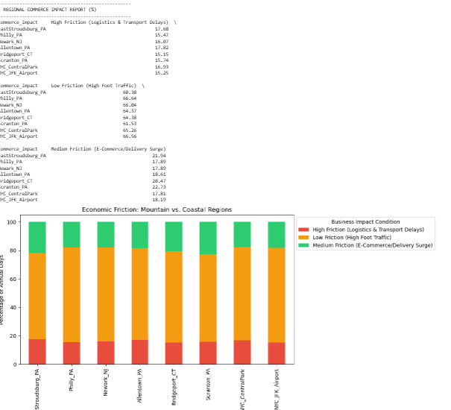
Rainfall & Economic Friction
With these findings you could look a locations Friction Coefficient and compare to another locations to then be able to see how much the environment “slows down” the traditional economy and forces a shift from physical to digital channels.
Example: A logistics company would be able to realize that in Scranton, they would need to account for a higher percentage in delivery surges when compared to NYC Central Park. This in turn means that people might be more inclined to order stuff online in Scranton, when compared to NYC Central Park.

Slide 9
Energy Demand Forecasting
Transitioning to inference models for municipal energy requirements using Heating Degree Days (HDD).
16,033
•
Baseline set to 65°F to quantify thermal deficit.
Predicted HDD
•
Model forecasted daily fluctuations within 1.15°F error.
•
Total predicted energy load: 16,033.8 HDD for the test period.
This means that over the last 60 days of the test sample, a utility provider would see this number and order fuel/power, as the AI predicted this potential usage, instead of just randomly guessing.
Allowing preemptive grid adjustments.
•

Slide 10
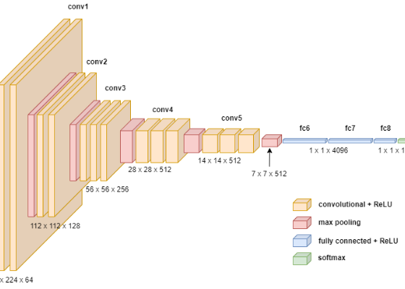
Deep Learning Architectures
Multilayer Perceptron (MLP)
Standard deep network. Achieved a remarkable R2 score of 0.9927, proving highly structural regional data.
CNN Surrogate
Adapted 1D weather sequences as a spatial grid. Proved that geographic "pixel patterns" could be extracted. Final MAE: 1.46°F.

Slide 11
Architecture Comparison Matrix
Quantitative and Qualitative Benchmarking of Sequential Models
Feature | Simple RNN | GRU | LSTM
Memory Length | Very Short | Medium/Long | Long-Term
Complexity | Low (1 Gate) | Medium (2 Gates) | High (3 Gates)
Training Speed | Fastest | Fast | Slower (Resource Intensive)
Gradient Stability | Poor (Vanishing) | Good | Excellent
Best Use Case | Simple Sequences | Efficiency/Speed | Complex Time-Series

Slide 12

Time Series Model Benchmarking
Simple RNN
GRU
LSTM
🔄
⚡
🧠
→ The Logic: Uses the hidden state of the previous step as input for the current.
→ The Logic: Uses "Update" and "Reset" gates to streamline information flow.
→ The Logic: Features a "Cell State" (long-term memory) and three complex gates.
→ The Flaw: Suffers from "Vanishing Gradients"—it forgets the start of the week by the time it reaches Friday.
→ The Trade-off: Faster and more efficient than LSTM, but lacks a dedicated memory cell.
→ The Win: Superior at maintaining thermal trends across weeks or months.
Model Architecture | Mean Absolute Error (MAE) | R2 Score | Characteristics
Simple RNN | 5.68°F | 0.8268 | Robust baseline; captures seasonal patterns despite gradient issues.
LSTM | 5.52°F | 0.8363 | Highest precision; preserves long-term state. High computational overhead.
GRU | 6.13°F | 0.8017 | Streamlined alternative; faster training time but slightly lower accuracy.
The Scientific Prediction: Why LSTM Wins
Weather is characterized by multi-scale dependencies. A cold snap like the one in 2026 isn't just a 24-hour event; it's the result of pressure systems moving over days. The LSTM's Forget Gate allows it to discard daily noise while preserving the overarching arctic trend, leading to the lowest MAE of 5.52°F.

Slide 13


Concluding Thoughts & Future Work
The experience provided valuable insight into regional weather precision, specifically confirming the superiority of LSTM architectures for meteorological time-series data.
If possible future Goals:
•
Acquire direct transactional/energy data to validate current inferences.
•
Expand usage of advanced Python libraries for non-linear modeling.
Special thanks to Dr. Che for project oversight.

